Slide 1
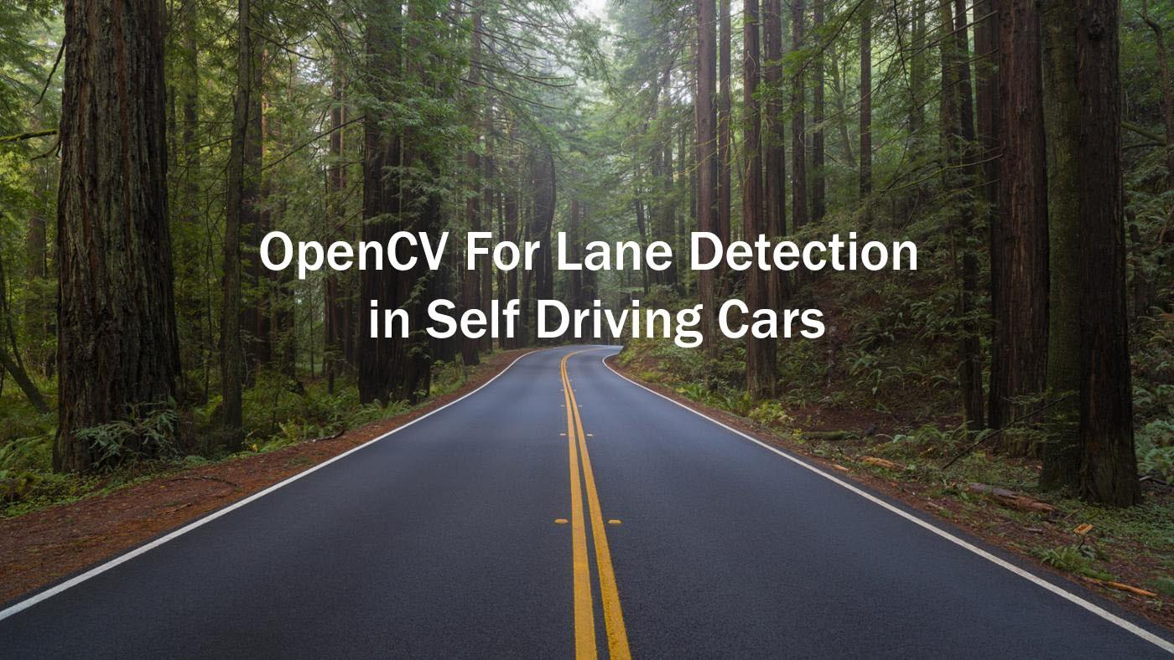
Road Laneline Detection
Road Lane Line Detection
Project By :
09 Yashaswi Ghune
32 Samruddhi Jadhav
36 Sakshi Jagtap
62 Punamtanvi Kshatriya
Data Science Course Project
Project By :
Yashaswi Ghune
Samruddhi Jadhav
Sakshi Jagtap
Punamtanvi Kshatriya

Slide 2
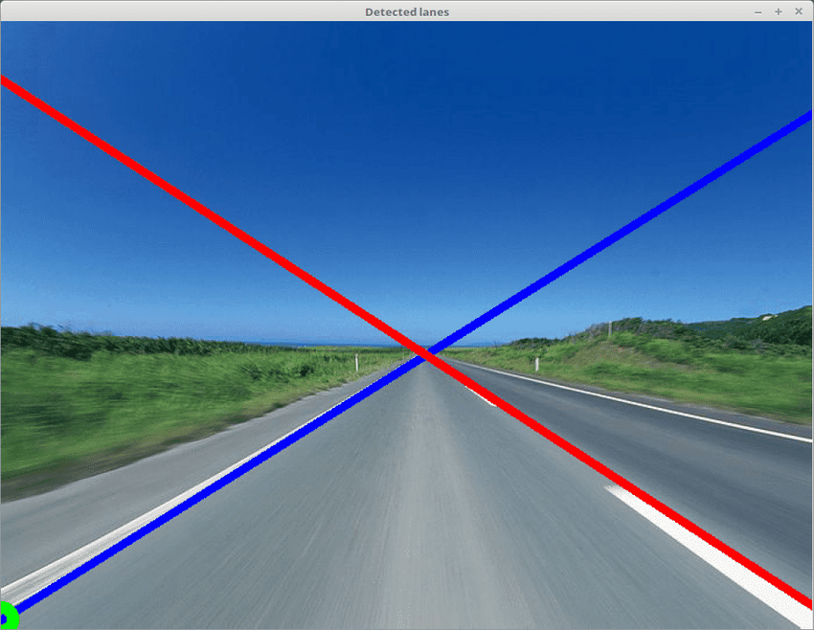
Tools and Technologies
jupyter Notebook
open-cv
matplotlib
numpy
moviepy

Slide 3
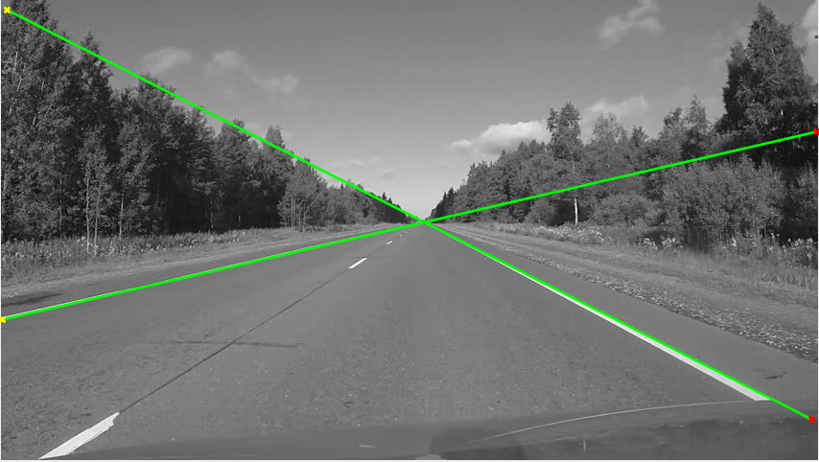
STEPS
Load test images.
Apply Color Selection
Apply Canny edge detection.
Apply gray scaling to the images.
Apply Gaussian smoothing.
Perform Canny edge detection.
Determine the region of interest.
Apply Hough transform.
Apply on video streams.

Slide 4
THANK YOU

